Slide 1

Fundamentals of Software Architecture Part 1
The experience to become a future software architect.

Slide 2

CONTENTS
Here’s what you’ll learn:
Setting Expectations
Introduction
The Big Picture (SDLC and Software architecture design)
Defining Software Architecture
Why are Software Architecture Fundamentals Crucial ?
Why is there no path for software architects?
Expectations of an Architect
Architectural Thinking and Planning

Slide 3
CONTENTS
Here’s what you’ll learn:
Software Architecture Principles
Separation of Concerns (SoC)
SoC Modularity
Bounded Context (Domain Driven Design)
Architecture characteristics
Component-Based Thinking
Architecture Styles Introduction
Monolithic Versus Distributed Architectures

Slide 4
01
02
03
Clarity on Core Principles
Best Practices for Clean Optimized Design
Deep Dive into Software Architecture
Setting Expectations
04
05
Real-world Examples & Case Studies
Developing Architect Career Path

Slide 5

The Big Picture

Slide 6


Slide 7

Design phase nature in Agile vs Waterfall

Slide 8
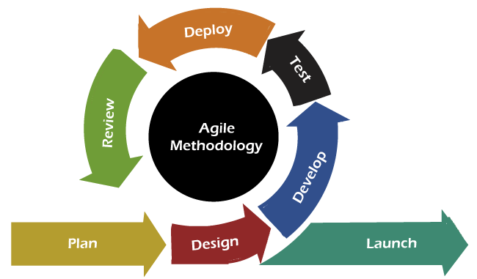
Design phase nature
Design phase nature
Agile is Iterative

Slide 9
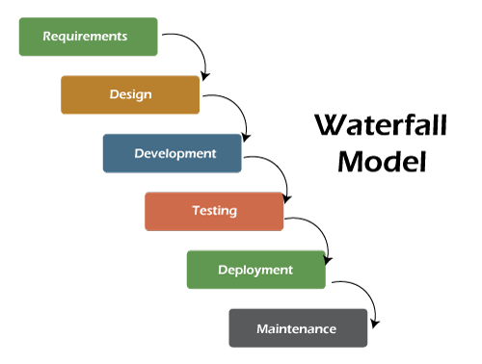
Design phase nature
Design phase nature
Waterfall is long-lasting

Slide 10

The revolution of DevOps and CI/CD.

Slide 11
The struggle to define Software architecture

Slide 12
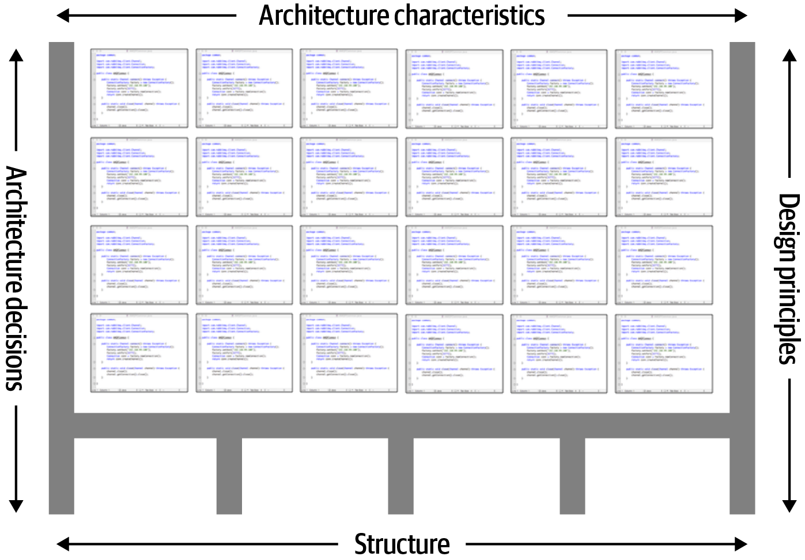
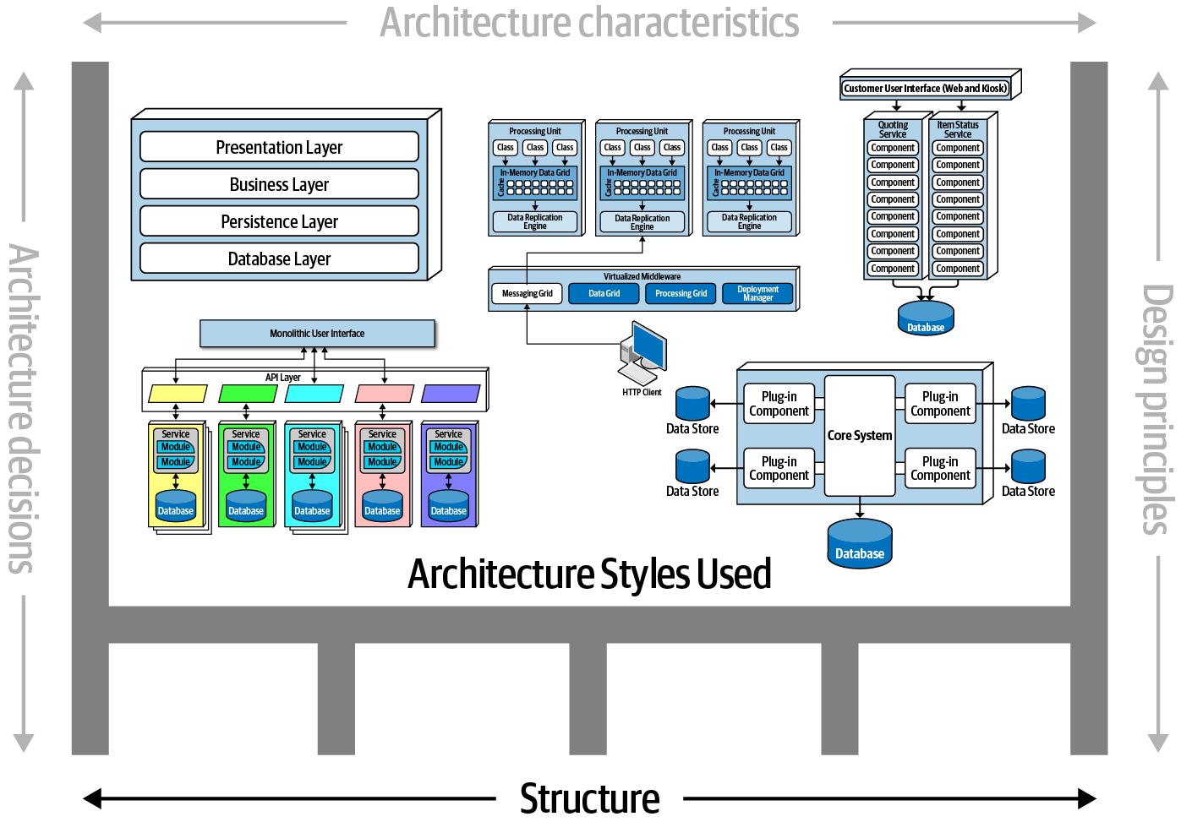
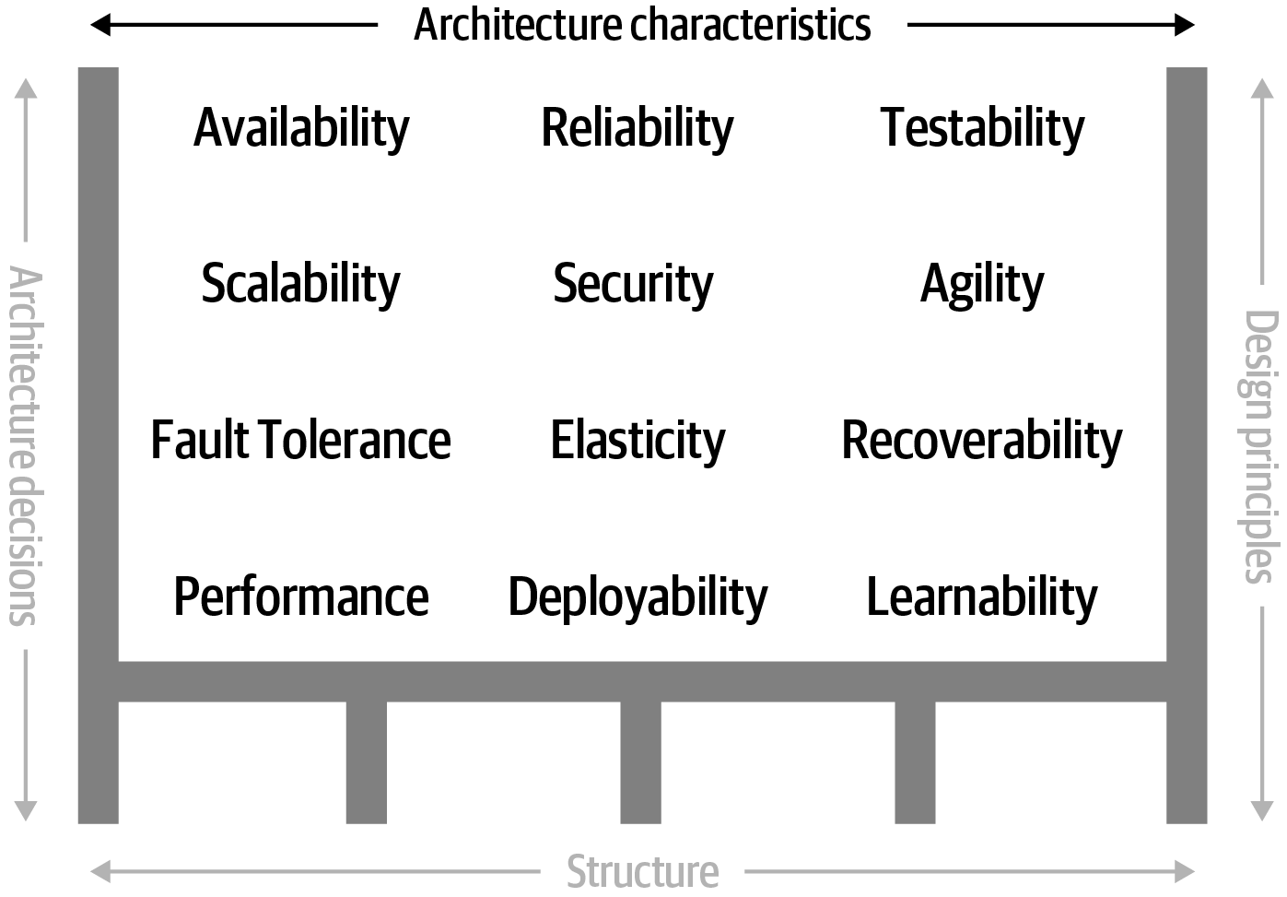

Slide 13

Much like art, must be understood within its context.
So, keep in mind that all architectures are a product of their context.

Slide 14

Why Good Software Architecture Matters??

Slide 15
Why Good Software Architecture Matters?
Core Design Decisions
Architecture represents the fundamental design decisions that shape a system.
These decisions are difficult and costly to change later, making early architectural choices critical for the system’s success.

Slide 16
Everything changes including norms

Slide 17
Why Good Software Architecture Matters?
Managing Change
Changes to a software system are inevitable.
A well-designed architecture facilitates change.
Adaptability as is crucial in dynamic business environments where requirements evolve.

Slide 18
Why Good Software Architecture Matters?
To meet requirements
Good Architecture ensures that the technical aspects of the system align with business objectives.
Ensuring the system delivers value to stakeholders.

Slide 19
Why Good Software Architecture Matters?
Balancing functional and non-functional requirements
Non-functional requirements must be also essential part of the architecture (defined as architecture characteristics).

Slide 20
Why Good Software Architecture Matters?
Easing communication among stakeholders
A well-defined architecture serves as a blueprint for all stakeholders, including developers, project managers, and business analysts.
Providing a common language and architecture artifacts allows them to understand the software system.

Slide 21
Why Good Software Architecture Matters?
Guides Development
Good architecture provides a clear framework and set of guidelines and best practices for the development team.
Reduces the complexity and prevent making incorrect decisions.
Architecture docs serves as training for team members.

Slide 22
Why Good Software Architecture Matters?
Providing a reusable model
Good architecture promotes reusability by identifying common patterns and components that can be reused across different parts of the system or even in other projects.
This reduces duplication of effort and speeds up development.

Slide 23
Why Good Software Architecture Matters?
Giving you the ability to predict software system qualities
By defining a clear and well-thought-out architecture, you can anticipate how the system will behave under various conditions.
This predictive capability allows for better planning, risk mitigation.

Slide 24
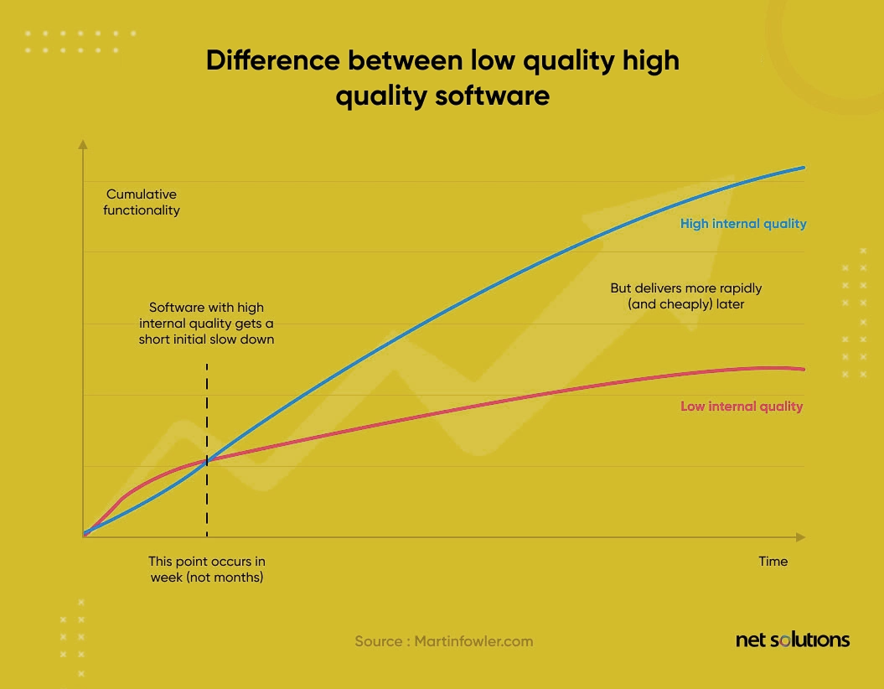
Ensure the longevity of the software’s internal quality.

Slide 25

Why is there no clear path for software architects?

Slide 26
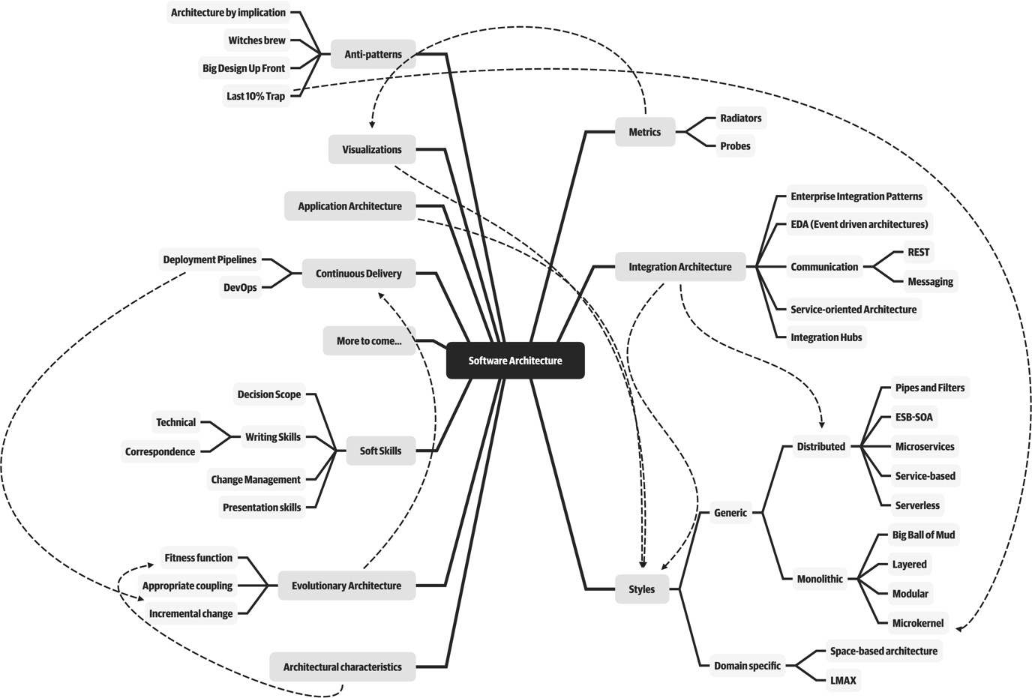
Expanded Role

Slide 27
Software architecture is a constantly moving target
Any definition cast today will be hopelessly outdated in a few years

Slide 28

Expectations of an Architect
Seven core expectations

Slide 29
Make architecture decisions
Expectations of an Architect
Guide rather than specify
Finding the correct line of decisions

Slide 30
Ensure compliance with decisions
Expectations of an Architect
Development teams are following architecture decisions and design principles defined.

Slide 31
Continually analyze the architecture
Expectations of an Architect
Seeking and suggest Improvements
NO Agility for code modifications

Slide 32
Diverse exposure and experience
Expectations of an Architect
Most environments these days are heterogeneous
Stretch the comfort zone
Keep Current with Latest Trends

Slide 33
Have business domain knowledge
Expectations of an Architect
To be effective software architect

Slide 34
Possess interpersonal skills
Expectations of an Architect
Exceptional interpersonal skills is a difficult expectation for most developers and architects
It’s always a people problem

Slide 35
Understand and navigate politics
Expectations of an Architect
Every decision an architect makes will be challenged

Slide 36

Architectural Thinking and Planning

Slide 37

Architectural Eye
Four main aspects
of thinking
like an architect

Slide 38
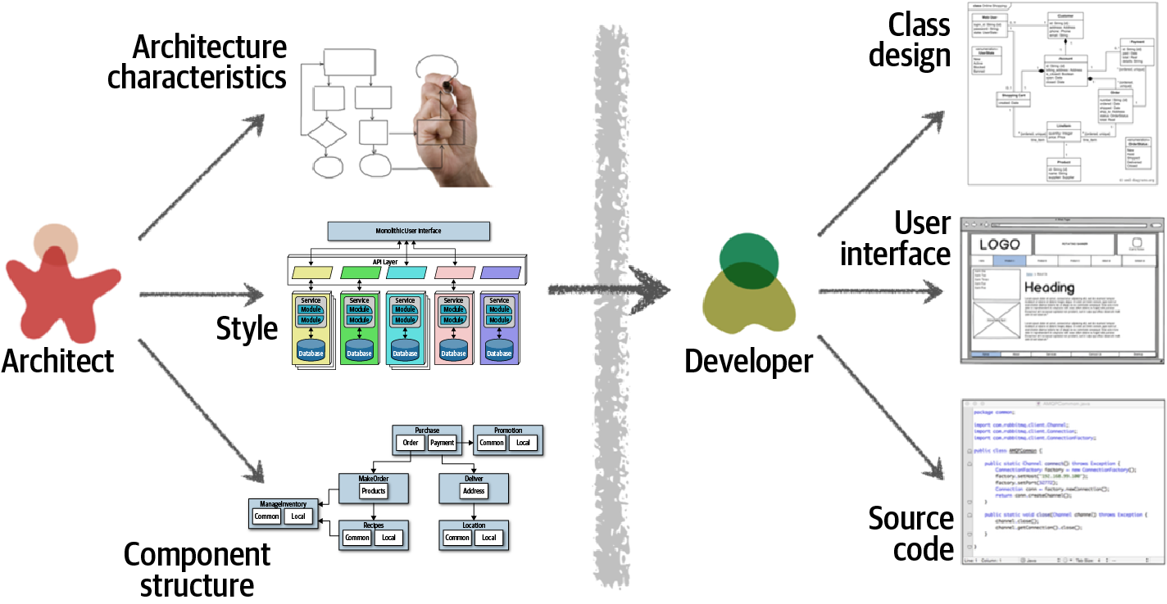
Architecture VS Design

Slide 39
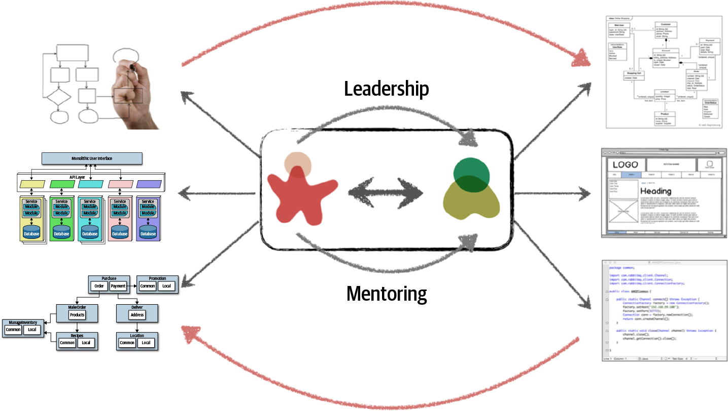
Architecture VS Design

Slide 40
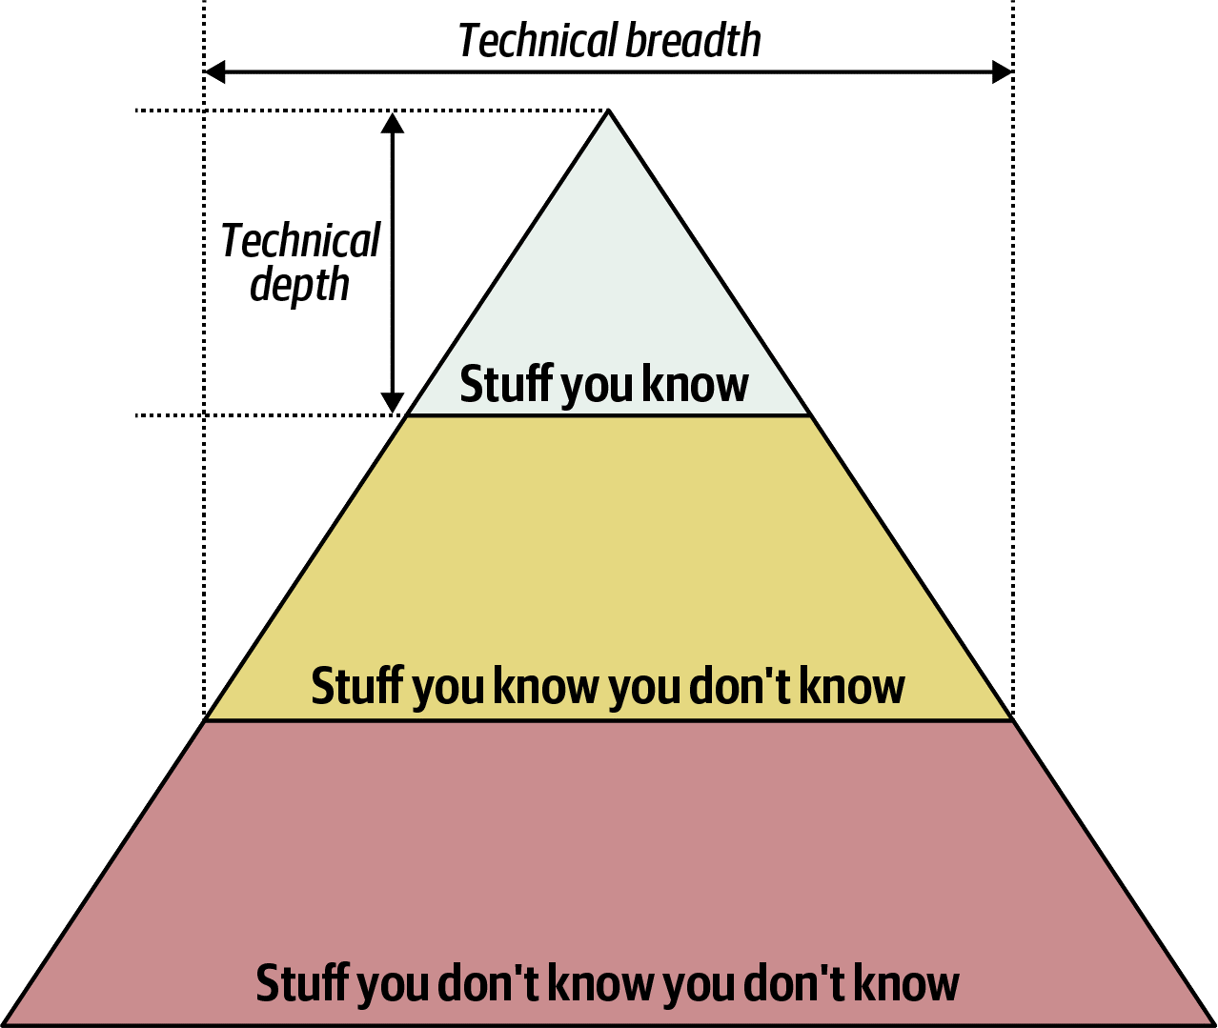
Technical Breadth and Technical Depth

Slide 41

Analyzing Trade-Offs
Architecture is the stuff you can’t Google.

Slide 42

Everything in architecture is a trade-off

Slide 43
Understanding Business Drivers
Translating those requirements into architecture characteristics

Slide 44

Balancing Architecture and Hands-On Coding

Slide 45
Balancing Architecture and Hands-On Coding
Bottleneck Trap
The only person capable of making changes or decisions regarding certain core parts of the codebase,
creates a single point of failure..

Slide 46
Balancing Architecture and Hands-On Coding
Bottleneck Trap
It can lead to frustration among team members
who are dependent on the architect's contributions to advance their work.

Slide 47
Bottleneck Trap
One way to avoid the bottleneck trap
First, delegate to dev team
then focus on coding a piece of business functionality

Slide 48
Bottleneck Trap
Three positive things happens
Gaining hands-on experience
Giving dev team ownership of the harder code parts (where it belongs).
Most important, Architect is writing the same business-related source code as the dev team.

Slide 49
Balancing Architecture and Hands-On Coding
Remain Hands-on & Technical Depth
without having to
practice coding from home

Slide 50
Remain Hands-on & Technical Depth
Doing frequent proof-of-concepts or POCs
Or doing frequent code reviews

Slide 51
Remain Hands-on & Technical Depth
Architect can tackle some of the technical debt..
While freeing the dev team up to work on the critical functional user stories.

Slide 52

Architectural Principles

Slide 53


Slide 54
Separation of Concerns SOC
One of the Most Fundamental Principle

Slide 55
2 out of 5 SOLID principles Based on SOC
Modularity
Single Responsibility
Interface Segregation
Notes:
Modularity : A higher level structural approach to implementing the Separation of Concerns (SoC) principle

Slide 56

Modularity
Notes:
Modularity : A higher level structural approach to implementing the Separation of Concerns (SoC) principle

Slide 57
95% of the words said about the benefits of “modularity” and that little is said about how to achieve it.

Slide 58
Modularity
How to measure Modularity?
High
Cohesion
is good

Slide 59

Modularity
Cohesion Measures
Functional cohesion Sequential cohesion Communicational cohesion Procedural cohesion Temporal cohesion Logical cohesion Coincidental cohesion

Slide 60


Modularity
For example,
Customer Maintenance:
add customer,
update customer,
get customer,
notify customer,
get customer orders,
cancel customer orders.
Customer Maintenance:
add customer, update customer, get customer, notify customer
Order Maintenance:
get customer orders, cancel customer orders

Slide 61
IT Depends..

Slide 62
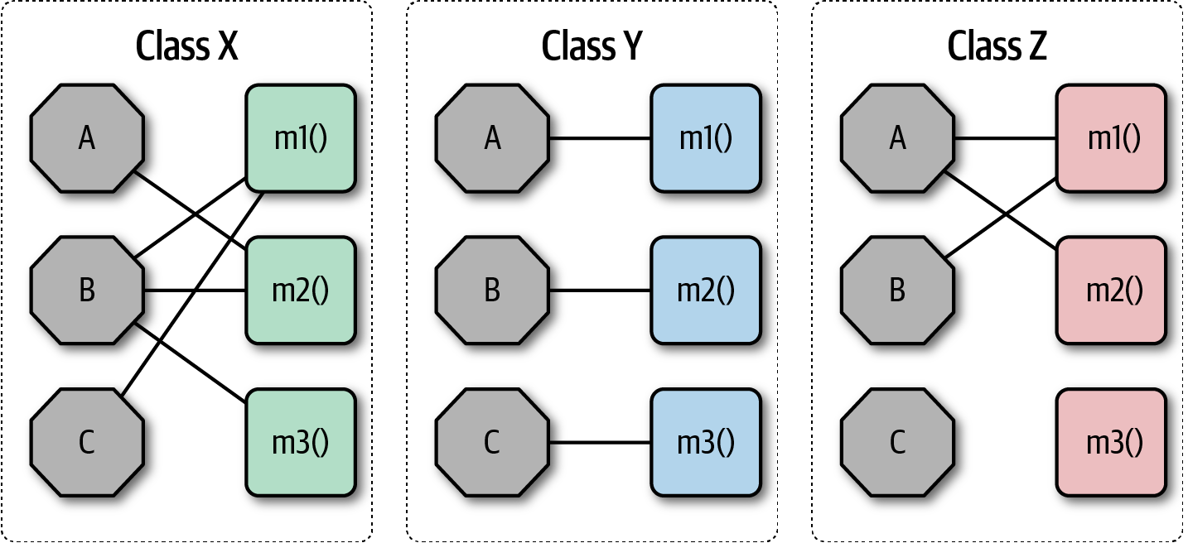
Modularity
Which is better in cohesion?

Slide 63
Modularity
Coupling
Loose
is good
Boost the flexibility, maintainability and scalability by “decoupling” your code !

Slide 64
Modularity
Decoupling Strategies Examples
Interface-based Design
Dependency Injection
Publish-Subscribe Patterns
Event-Driven Architectures
Microservices Architecture
...
..

Slide 65
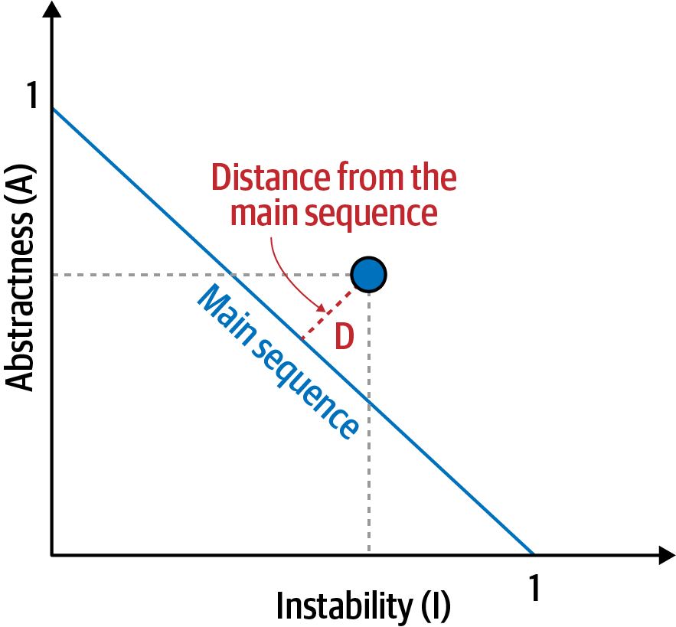
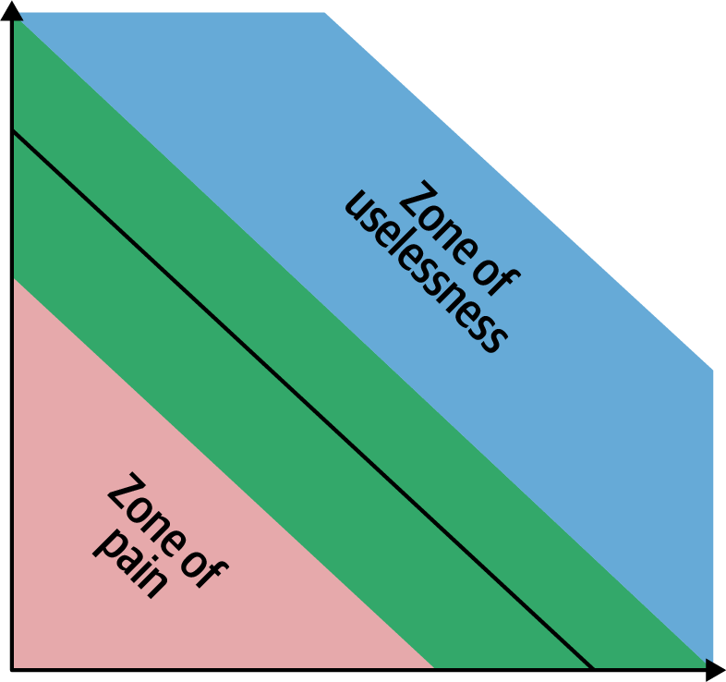
Modularity
Balanced approach

Slide 66

Architecture characteristics
Notes:
Key to success of the overall system

Slide 67
One key responsibility of a software architect
Defining,
discovering,
and analyzing
architectural characteristics
Notes:
Architects may collaborate on defining the domain or business requirements, but as a must, one key responsibility entails defining, discovering, and analyzing architectural characteristics as it isn’t directly related to the domain functionality.

Slide 68

Notes:
What is the diff between elasticity and scalability

Slide 69
An architecture characteristic meets three criteria
Specifies a nondomain design consideration
Notes:
architecture characteristics specify operational and design criteria for success, Concerning how to implement the requirements and why certain choices were made.
For example, a common important architecture characteristic specifies a certain level of performance for the application, which often doesn’t appear in a requirements document.
no requirements document states “prevent technical debt,” but it is a common design consideration for architects and developers.

Slide 70
An architecture characteristic meets three criteria
Influences some structural aspect of the design
Notes:
The primary reason to describe the characteristics is : does this architecture characteristic require special structural consideration and modifications to succeed? If Yes then it is a crucial one to address.
For example, security. However, it rises to the level of architectural characteristic when the architect needs to design something special for the requirements. Meaning require special structural modifications to ensure the success criteria of the design.
Consider these two cases surrounding payment:
Third-party payment processor If an integration point handles payment, then the architecture shouldn’t require special structural considerations. The design has standard security hygiene, such as encryption and hashing.
In-application payment processing If the application must handle payment processing, the architect may design a specific module, component, or service to isolate the critical security concerns structurally. Now, the architecture characteristic has an impact on both architecture and design. (meaning it will be affecting/impacting the other structural aspect of the design).

Slide 71
An architecture characteristic meets three criteria
Only the ones are critical or important to application success
Make trade-offs.
Notes:
Support for each architecture characteristic adds complexity to the design and structure .
a bigger problem is that some characteristics can conflict with others.
For example, if an architect wants to improve security, it will almost certainly negatively impact performance: the application must do more on-the-fly encryption, indirection for secrets hiding, and other activities that potentially degrade performance.
a critical job for architects lies in making trade-offs between several competing concerns, choosing the fewest critical architecture characteristics

Slide 72
Characteristics Categorized

Slide 73
Identifying Characteristics
Operational
Availability
Performance
Structural
Maintainability
Portability
Cross-Cutting
Authentication
Authorization
Scalability
Elasticity
…
Extensibility
Configurability
…
Security
Accessibility
…
Notes:
Many of the definitions overlap and no complete list of standards exists. For example, consider availability and reliability, which seem to overlap in almost all cases.
architects and Employees can use ubiquitous language to solve this lack of standard definition and create their own.
Availability
How long the system will need to be available (if 24/7, steps need to be in place to allow the system to be up and running quickly in case of any failure).
Performance
Includes stress testing, peak analysis, analysis of the frequency of functions used, capacity required, and response times. Performance acceptance sometimes requires an exercise of its own, taking months to complete.
Maintainability
How easy is it to apply changes and enhance the system?
Portability
Does the system need to run on more than one platform? (For example, does the frontend need to run against Oracle as well as SAP DB?
Configurability
Ability for the end users to easily change aspects of the software’s configuration (through usable interfaces).
Extensibility
How important it is to plug new pieces of functionality in.
Accessibility
Access to all your users, including those with disabilities like colorblindness or hearing loss.
Authentication
Security requirements to ensure users are who they say they are.
Authorization
Security requirements to ensure users can access only certain functions within the application (by use case, subsystem, webpage, business rule, field level, etc.).
Security
Does the data need to be encrypted in the database? Encrypted for network communication between internal systems? What type of authentication needs to be in place for remote user access?

Slide 74
Identifying Architectural Characteristics
Notes:
An architect uncovers architecture characteristics in at least three ways

Slide 75
Identifying Characteristics
Extracting architecture characteristics from domain concerns
Notes:
An architect must be able to translate domain concerns to identify the right architectural characteristics.
implicitly come from inherent domain knowledge by architects, one of the many reasons that domain knowledge is always beneficial for architects.
collaborating with domain stakeholders to define the characteristics and to keep the final list as short as possible.(select the top three most important characteristics)
One problem is that architects and domain stakeholders speak different languages. (Architects talk about scalability, interoperability, fault tolerance, etc. Domain stakeholders talk about mergers and acquisitions, user satisfaction, time to market, and competitive advantage.
there is usually a translation from domain concerns to architecture characteristics.

Slide 76
Identifying Characteristics
Translation of domain concerns to architecture characteristics
Domain concern | Architecture characteristics
Mergers and acquisitions | Interoperability, scalability, adaptability, extensibility
Time to market | Agility, testability, deployability
User satisfaction | Performance, availability, fault tolerance, testability, deployability, agility, security
Competitive advantage | Agility, testability, deployability, scalability, availability, fault tolerance
Time and budget | Simplicity, feasibility
Notes:
An architect must be able to translate domain concerns to identify the right architectural characteristics.
collaborating with domain stakeholders to define the characteristics and to keep the final list as short as possible.(select the top three most important characteristics)
One problem is that architects and domain stakeholders speak different languages. (Architects talk about scalability, interoperability, fault tolerance, etc. Domain stakeholders talk about mergers and acquisitions, user satisfaction, time to market, and competitive advantage.
there is usually a translation from domain concerns to architecture characteristics.

Slide 77
Identifying Characteristics
A trap, focusing on only one of the ingredients
Notes:
“Due to regulatory requirements, it is absolutely imperative that we complete end-of-day fund pricing on time.”
An ineffective architect might just focus on performance as it seems to be the primary focus of that domain concern. However, that architect will fail for many reasons. First, it doesn’t matter how fast the system is if it isn’t available when needed. Second, as the domain grows the system must be able to also scale to finish end-of-day processing in time. Third, the system must also be reliable so that it doesn’t crash as end-of-day fund prices are being calculated. Fourth, what if the system crashes in the middle of processing? It must be able to recover and restart where the pricing left off. Finally, are the fund prices being calculated correctly? So, in addition to performance, the architect must also equally place a focus on availability, scalability, reliability, recoverability, and auditability.

Slide 78
Identifying Characteristics
Extracting Architecture Characteristics from Requirements
Notes:
adopt a curious approach, actively seeking more detailed requirements and clarifying assumptions
For example, suppose an architect designs an application that handles class registration for university students. assume that the school has 1,000 students and 10 hours for registration. Should an architect design a system assuming consistent scale, making the implicit assumption that the students during the registration process will distribute themselves evenly over time? Or, based on knowledge of university students' habits and proclivities, should the architect design a system that can handle all 1,000 students attempting to register in the last 10 minutes? Rarely will details like this appear in requirements documents.

Slide 79
Identifying Characteristics
Architecture katas
nealford.com/katas
Notes:
architecture katas, a clever method to allow architects a way to practice deriving architecture characteristics from domain-targeted descriptions.

Slide 80
Identifying Characteristics
Case Study: Silicon Sandwiches (Architecture Kata)
Description:
A national sandwich shop wants to enable online ordering (in addition to its current call-in service).
Users:
Thousands, perhaps one day millions
Requirements:
Users will place their order, then be given a time to pick up their sandwich and directions to the shop (which must integrate with several external mapping services that include traffic information)
If the shop offers a delivery service, dispatch the driver with the sandwich to the user
Mobile-device accessibility
Offer national daily promotions/specials
Offer local daily promotions/specials
Accept payment online, in person, or upon delivery
Additional context
Sandwich shops are franchised, each with a different owner
Parent company has near-future plans to expand overseas
Corporate goal is to hire inexpensive labor to maximize profit
Notes:
First, separate the candidate architecture characteristics into explicit and implicit characteristics.
One of the first details that should catch an architect’s eye is the number of users: currently thousands, perhaps one day millions (this is a very ambitious sandwich shop!)
Thus, scalability—handle a large number of users—is one of the top architecture characteristics. Notice that the problem statement didn’t explicitly ask for scalability,
However, we also probably need elasticity.
The requirement for elasticity did not appear in requirements, yet the good architect should identify this as an important consideration.

Slide 81
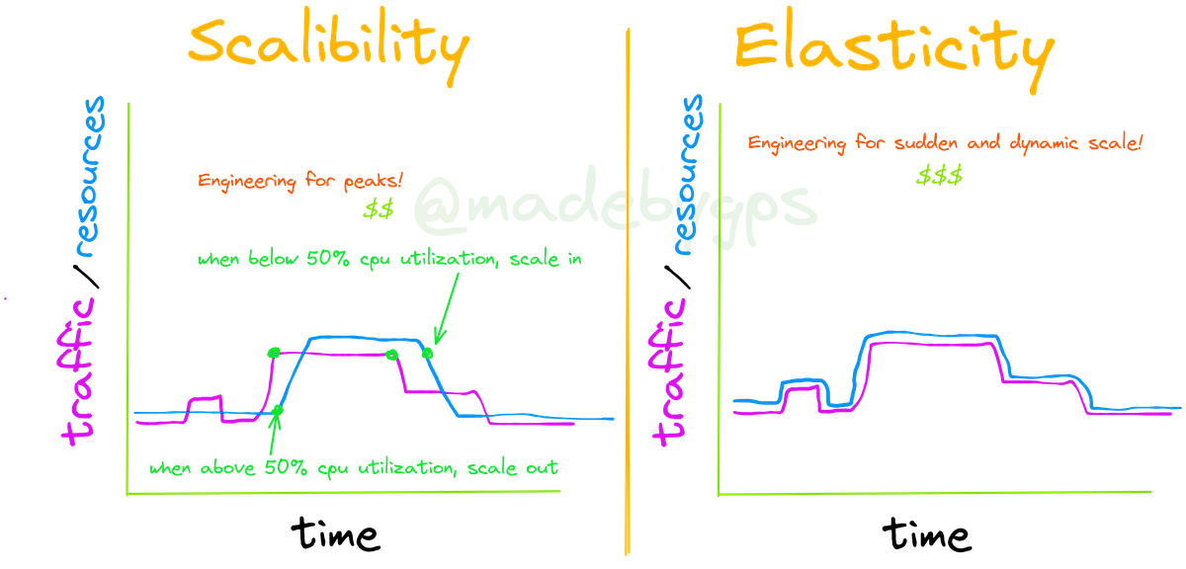
time
time
Notes:
Scalability
Ability for the system to perform and operate as the number of users or requests increases. It has two types : Vertical or Horizontal Scaling.
Elasticity
Ability for the system to automatically or dynamically scale resources up or down as needed, in response to changing unexpected demand. It is a more dynamic concept than scalability.
Some systems are scalable but not elastic.
For example, consider a hotel reservation system. Normal days vs special sales days.
Elasticity adds a layer of intelligence and automation to scalability.
Elasticity is crucial in cloud computing, where the pay-as-you-go pricing model makes elasticity economically attractive.

Slide 82
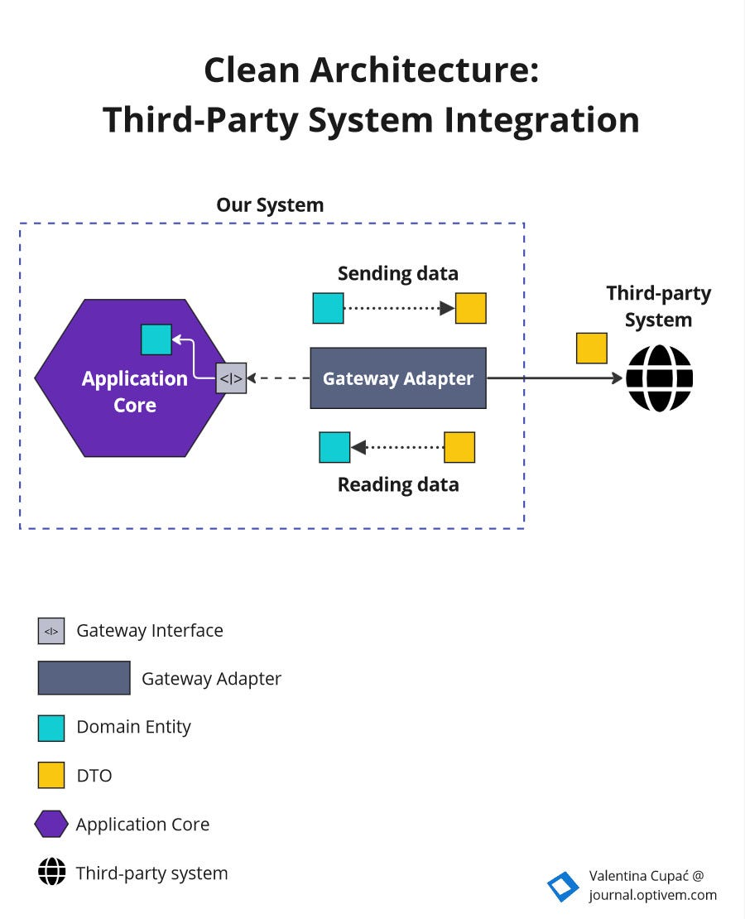
Case Study: Silicon Sandwiches
Explicit Characteristics
Requirements:
Users will place their order, then be given a time to pick up their sandwich and directions to the shop (which must integrate with several external mapping services that include traffic information)
Impact the reliability
Notes:
External mapping services imply integration points, which may impact aspects such as reliability. For example, if a developer builds a system that relies on a third-party system, yet calling it fails.
Be wary of over-specifying architecture characteristics.

Slide 83
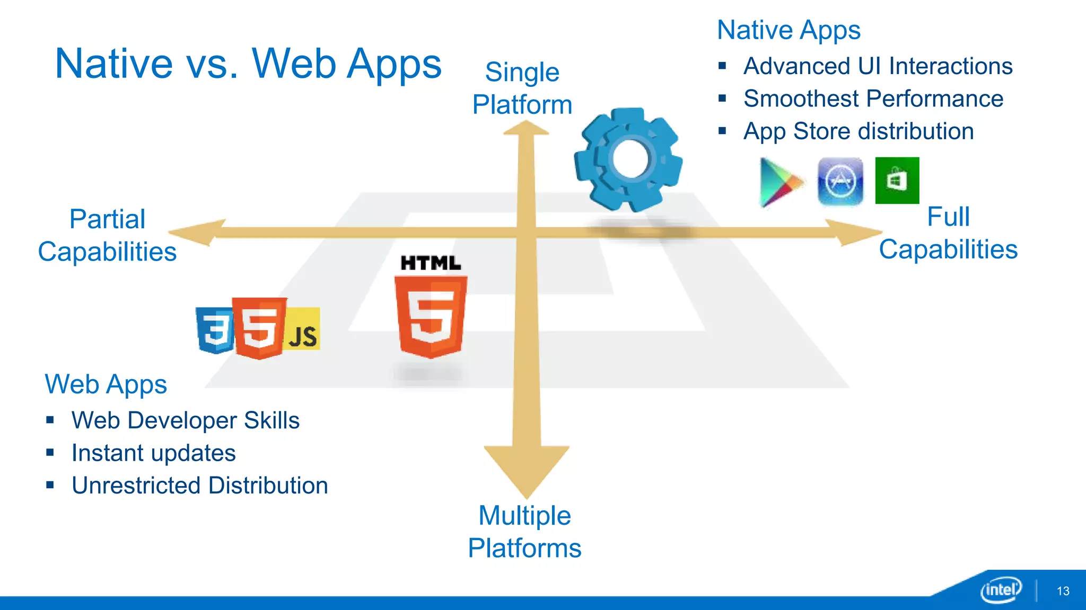
Case Study: Silicon Sandwiches
Explicit Characteristics
Requirements:
Mobile-device accessibility.
Primarily affect the design of the application
Notes:
This requirement will primarily affect the design of the application, pointing toward building either a portable web application or several native web applications.
Given the budget constraints and simplicity of the application, the design points toward a (portable or progressive web) mobile-optimized web application.
Thus, the architect may define some specific performance architecture characteristics for page load time and other mobile-sensitive characteristics.
Notice the architect should collaborate with user experience designers, domain stakeholders, and other interested parties to vet decisions like this.

Slide 84
Case Study: Silicon Sandwiches
Explicit Characteristics
Requirements:
Offer national daily promotions/specials.
Offer local daily promotions/specials
Both of these requirements specify customizability
Notes:
Both of these requirements specify customizability. Notice that requirement one also implies customized traffic information based on address.
the architect may consider customizability as an architecture characteristic.
For example, an architecture style such as microkernel architecture supports customized behavior extremely well by defining a plug-in architecture. In this case, the default behavior appears in the core, and developers write the optional customized parts, based on location, via plug-ins.
However, a traditional design can also accommodate this requirement via design patterns (such as Template Method).
This is common in architecture and requires architects to constantly weigh trade-offs between competing options.

Slide 85
Case Study: Silicon Sandwiches
Explicit Characteristics
Requirements:
Accept payment online, in person, or upon delivery.
Online payments imply security, but nothing in this requirement suggests a special heightened level of security.

Slide 86
Case Study: Silicon Sandwiches
Explicit Characteristics
Requirements:
Sandwich shops are franchised, each with a different owner.
This requirement may impose cost restrictions on the architecture—the architect should check the feasibility regarding each owner.
Notes:
Since each franchise is owned by a different individual or entity, the financial resources available for technology investments can vary widely. Some owners may have limited budgets, which means the architecture must be cost-effective to implement and maintain.

Slide 87
Case Study: Silicon Sandwiches
Explicit Characteristics
Requirements:
The parent company has near-future plans to expand overseas.
This requirement implies internationalization, or i18n.
But shouldn’t require special structure to accommodate.
Notes:
Many ui ux design techniques exist to handle this requirement, which shouldn’t require special structure to accommodate.
Resource Bundling : Store all user-facing text, images, and cultural formats (dates, currencies) in external resource files (e.g., properties files, JSON, XML)

Slide 88
Case Study: Silicon Sandwiches
Explicit Characteristics
Requirements:
The corporate goal is to hire inexpensive labor to maximize profit.
This implies Usability, but again is more concerned with design than architecture characteristics.
Notes:
This requirement suggests that usability will be important, but again is more concerned with design than architecture characteristics (No need to consider it).

Slide 89
Case Study: Silicon Sandwiches
Implicit Characteristics
Performance
No one wants to buy from a sandwich shop that has poor performance, especially at peak times.
Notes:
The third architectural characteristic we derive from the preceding requirements is performance: no one wants to buy from a sandwich shop that has poor performance, especially at peak times. However, performance is a nuanced concept—what kind of performance should the architect design for?

Slide 90
Case Study: Silicon Sandwiches
Implicit Characteristics
Availability & Reliability
Availability: making sure users can access the sandwich site. Closely related to Reliability
—again, no one wants to purchase from a site that continues dropping connections.
Notes:
Many architecture characteristics aren’t specified in requirements documents, yet they make up an important aspect of the design.
Availability: making sure users can access the sandwich site. Closely related to availability is reliability: making sure the site stays up during interactions—no one wants to purchase from a site that continues dropping connections.

Slide 91
Case Study: Silicon Sandwiches
Implicit Characteristics
Security
No one wants to create insecure software.
Notes:
Security appears as an implicit characteristic in every system
However, it may be prioritized depending on criticality.
An architect might assume that payments should be handled by a third party. Thus, as long as developers follow the good design and general security hygiene (not passing credit card numbers as plain text, not storing too much information, and so on), the architect shouldn’t need any special structural design to accommodate security.

Slide 92
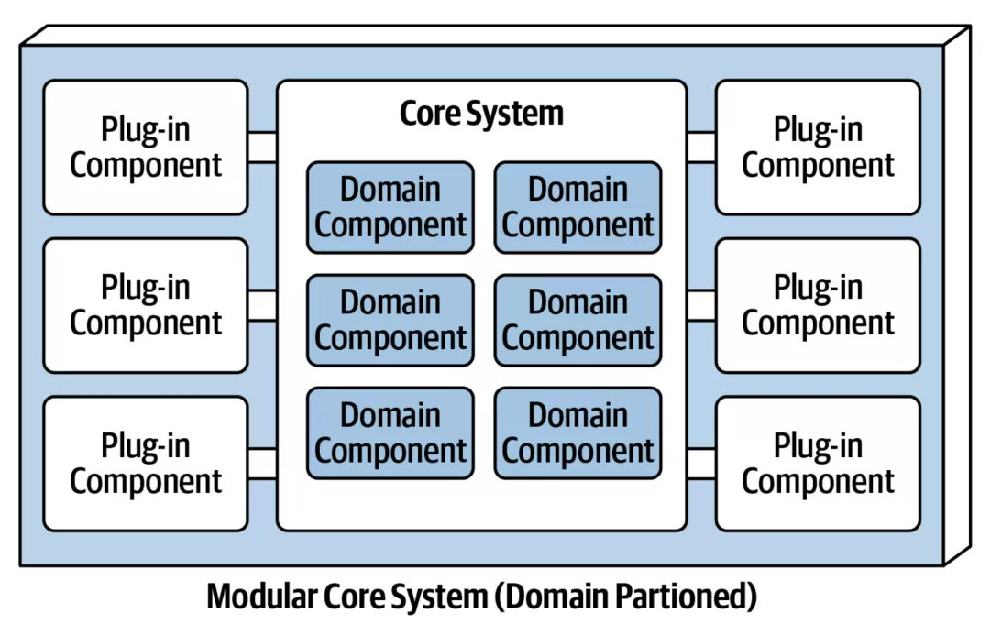
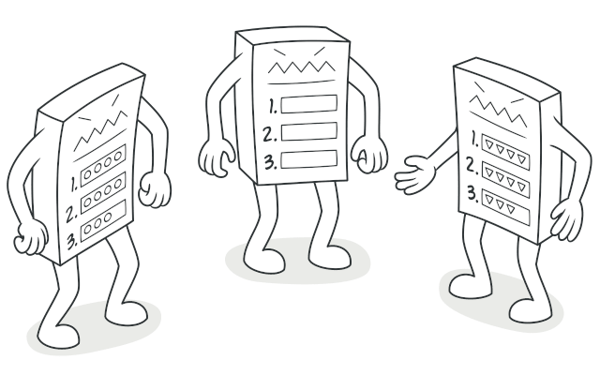
DESIGN VERSUS ARCHITECTURE TRADE-OFFS
Regarding Customizability characteristic
Notes:
problem domain offer custom behavior: recipes, local sales, and directions that may be locally overridden.
This design element isn’t critical to the success of the application though.
but the question then becomes: architecture or design? Note design resides within the architecture
The architect could choose microkernel.
competing concerns, developers could implement the customization using the Template Method design pattern.
Which design is better? it depends
are there good reasons, such as performance and coupling, not to implement a microkernel architecture?
Second, are other architecture characteristics more difficult in one design versus the other?
Third, the cost to support all the architecture characteristics in each design versus pattern?
This type of architectural trade-off analysis makes up an important part of an architect’s role.

Slide 93

Measuring Characteristics

Slide 94
Operational Measures
THE MANY FLAVORS OF PERFORMANCE
Request-response cycles
First-page render times to a target (500 ms)
K-weight budgets for page downloads
Notes:
Performance exhibits remarkable depth and variety, extending beyond general metrics like request-response cycles. Architects and DevOps engineers have developed detailed performance budgets to address specific application areas, such as optimizing first-page render times to a target of 500 ms to enhance user engagement. Furthermore, progressive organizations have introduced K-weight budgets for page downloads, setting limits on the bytes' worth of libraries and frameworks to accommodate physical network constraints, particularly for mobile devices in areas with high latency. This nuanced approach to performance, tailored to the unique demands of modern web and mobile applications, illustrates the intricate measures organizations adopt to refine user experience and operational efficiency.

Slide 95
Structural Measures
CC = E - N + 2
CYCLOMATIC
COMPLEXITY
public void decision(int c1, int c2) {
if (c1 < 100) // point of decision
return 0;// possible decision
else if (c1 + C2 > 500)// point of decision
return 1;// possible decision
else
return -1;// possible decision
}
//The cyclomatic complexity for Example is 3 (=3 – 2 + 2)
Notes:
What about measuring internal structural characteristics, such as well-defined modularity? Some metrics and common tools do allow architects to address some critical aspects of code structure,
An obvious measurable aspect of code is complexity, defined by the cyclomatic complexity metric.
(CC) is a code-level metric designed to provide an objective measure for the complexity of code, at the function/method, class, or application level, developed by Thomas McCabe, Sr., in 1976.
It is computed by applying graph theory to code, specifically code decision points, which cause different execution paths. For example, if a function has no decision statements (such as if statements), then CC = 1. If the function had a single conditional, then CC = 2 because two possible execution paths exist.
The formula CC = E - N + 2, where N represents nodes (points of decision), and E represents edges (possible decisions). Consider the C-like code.

Slide 96
Structural Measures
CYCLOMATIC
COMPLEXITY
WHAT’S A GOOD VALUE FOR CYCLOMATIC COMPLEXITY?
It depends!
But in general, under 10 is acceptable.
Notes:
It depends on the complexity of the problem domain.
are functions complex because of the problem domain or because of poor coding?
In general, the industry thresholds for CC suggest that a value under 10 is acceptable, barring other considerations such as complex domains.
Engineering practices like test-driven development have the accidental (but positive) side effect of generating smaller, less complex methods on average for a given problem domain. When practicing TDD, developers try to write a simple test, then write the smallest amount of code to pass the test. This focus on discrete behavior and good test boundaries encourages well-factored, highly cohesive methods that exhibit low CC.

Slide 97
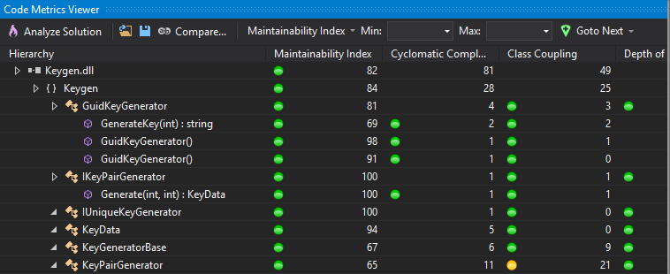
Structural Measures
Tools for Code Analysis
https://learn.microsoft.com/en-us/visualstudio/code-quality/code-metrics-values?view=vs-2022
Notes:
Various tools for code analysis exist that can help architects and developers evaluate different aspects of code quality. Tools like those available in Visual Studio provide insights into code maintainability, cyclomatic complexity, potential bugs, and adherence to coding standards. These tools, while limited and not offering a comprehensive measure of internal code quality, enable the identification and mitigation of critical structural issues. For example, static analysis tools can detect code smells, duplicated code, and overly complex methods, guiding refactoring efforts. Teams can continuously monitor and improve code quality, addressing some of the critical aspects of code structure.

Slide 98
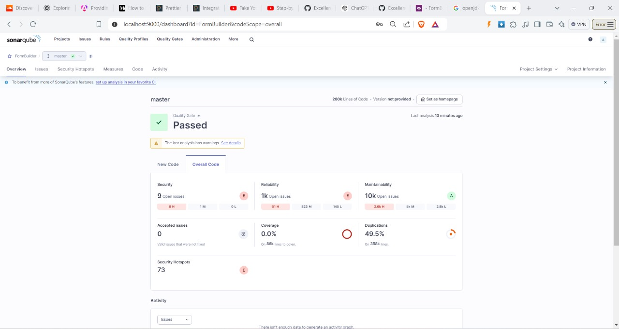
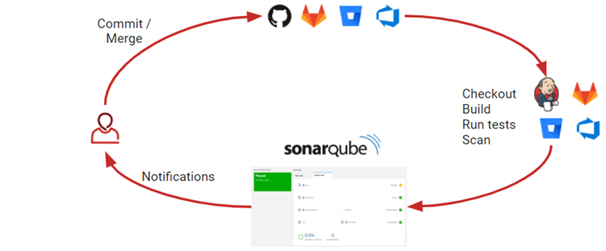
Tools for Code Analysis
SonarQube
Notes:
SonarQube is an open-source platform developed by SonarSource for continuous inspection of code quality.
It performs automatic reviews with static analysis of code to detect bugs, code smells, and security vulnerabilities.
Architectural Implications
Microservices Governance: SonarQube can help maintain consistency across microservices by enforcing uniform code quality standards, crucial for large-scale distributed systems.
Technical Debt Quantification: It provides a "Technical Debt Ratio" metric, allowing architects to quantify and track the long-term impact of design decisions over time.
Architectural Decay Detection: By tracking metrics like coupling and cohesion over time, SonarQube can alert architects to gradual architectural decay that might otherwise go unnoticed.

Slide 99
SonarQube
Pitfalls and Considerations
False Positives
Performance Impact
Security Implications
Notes:
False Positives: Be aware that static analysis can produce false positives. Architects should guide teams on when to use @SuppressWarnings judiciously.
Performance Impact: Large-scale analysis can be resource-intensive. Plan for appropriate hardware allocation, especially in CI/CD pipelines.
Security Implications: While SonarQube can identify many security vulnerabilities, it shouldn't be the sole security measure. Combine it with other security practices and tools.

Slide 100
SonarQube
Metrics for Architectural Decision Making
Cyclomatic Complexity Trending
Package Tangle Index
Code Coverage vs. Complexity
Notes:
Cyclomatic Complexity Trending: Use this to identify parts of the system that are becoming too complex and may need refactoring or redesign.
Package Tangle Index: This lesser-known metric helps identify architectural layers that are becoming too interdependent.
Code Coverage vs. Complexity: Correlate these metrics to identify high-risk areas that are complex but poorly tested.

Slide 101
SonarQube
Long-term Strategic Use
Architectural Fitness Functions
Technical Debt Budgeting
Developer Workflow Integration
Notes:
Architectural Fitness Functions: Use SonarQube metrics as part of your architectural fitness functions to ensure the architecture evolves in the desired direction.
Technical Debt Budgeting: Use the quantified technical debt metrics for informed discussions with stakeholders about allocating resources for code improvement versus new feature development.
Developer Workflow Integration: Beyond CI/CD, integrate SonarQube into IDEs and code review processes to catch issues earlier in the development cycle.

Slide 102

Governing Characteristics
Notes:
Once architects have established architecture characteristics and prioritized them, how can they make sure that developers will respect those priorities?
Modularity is a great example of an aspect of architecture that is important but not urgent; on many software projects, urgency dominates, yet architects still need a mechanism for governance.
Governance is an important responsibility of the architect role.
the scope of architecture governance covers any aspect of the software development process and negligence can lead to disastrous quality problems.
Fortunately, The drive toward automation on software projects spawned by Extreme Programming created continuous integration, which we now call DevOps, continuing through to architectural governance.

Slide 103
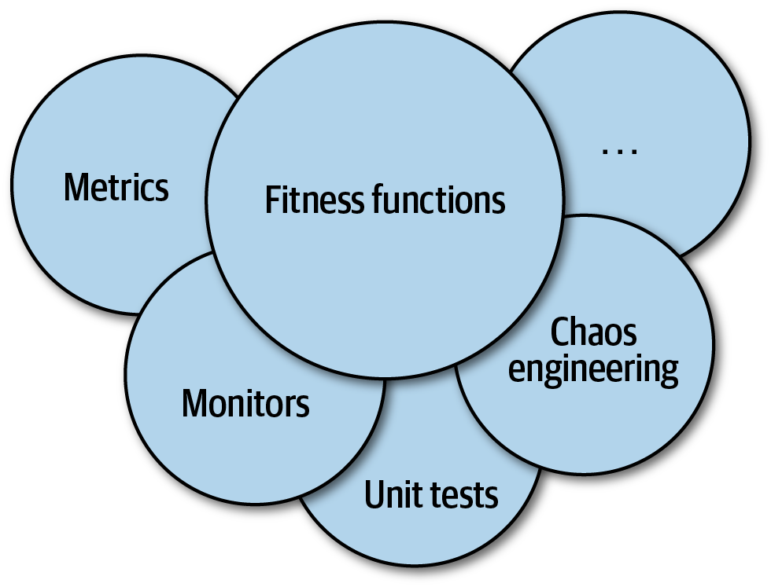
Fitness Functions
Notes:
An architect may want to provide an objective measure indicating the quality of the outcome.
assess some architecture characteristic or combination .. how close the output comes to achieving the aim.

Slide 104
Fitness Functions
Cyclic Dependencies
Poorly maintained modularity
harms the structure of a code base!
Notes:
Modularity is an implicit architecture characteristic that most architects care about, because poorly maintained modularity harms the structure of a code base; thus, architects should place a high priority on maintaining good modularity.
Most programmers develop the habit of swatting the auto-import dialog away like a reflex action. However, importing classes or components between one another spells disaster for modularity.
Remember Always hit remove and sort usings
How can architects govern this behavior without constantly looking over the shoulders of developers? Code reviews help but happen too late.
The solution to this problem is to write a fitness function to look after cycles, as shown in the next example.

Slide 105
Fitness Functions
Cyclic Dependencies
using NUnit.Framework; using System.Collections.Generic; using NetDepend; namespace MyProject.Tests { [TestFixture] public class CycleTest { private NetDepend netDepend; [SetUp] public void Init() { netDepend = new NetDepend(); netDepend.AddDirectory(@"\path\to\project\persistence\classes"); netDepend.AddDirectory(@"\path\to\project\web\classes"); netDepend.AddDirectory(@"\path\to\project\thirdpartyjars"); } [Test] public void TestAllPackages() { var packages = netDepend.Analyze(); Assert.IsFalse(netDepend.ContainsCycles(), "Cycles exist"); } } }
Notes:
Note: Architects must ensure that developers understand the purpose of the fitness function before imposing it on them.

Slide 106
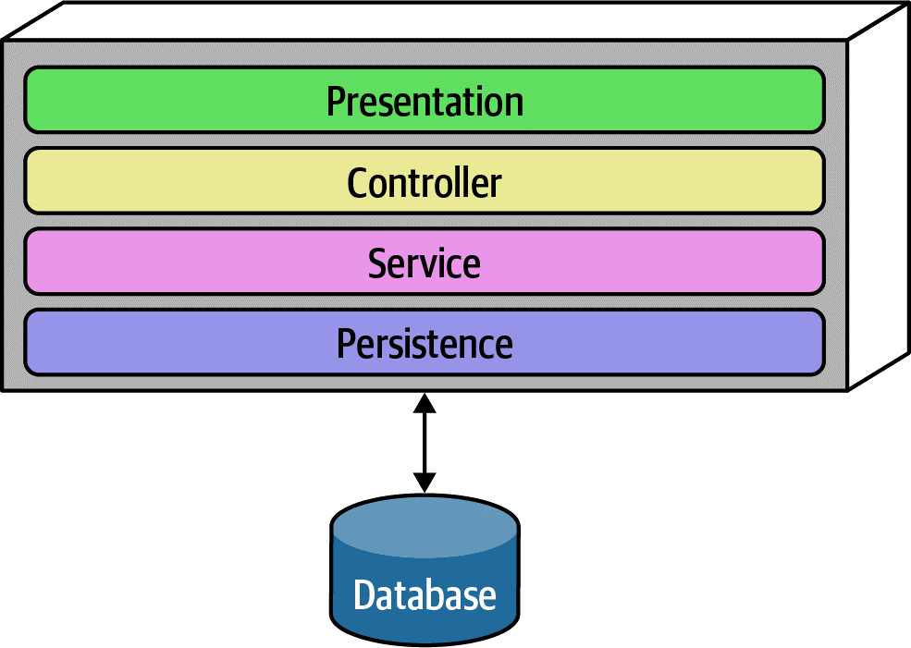
Fitness Functions
How can architects ensure that developers adhere to the intended layered architecture?
Notes:
One such tool is ArchUnit, a Java testing framework. ArchUnit provides a variety of predefined governance rules codified as unit tests and allows architects to write specific tests that address modularity.
When designing a layered monolith, the architect defines the layers for good reason (motivations, trade-offs, and other aspects of the layered architecture). However, how can the architect ensure that developers will respect those layers? Some developers may not understand the importance of the patterns. But allowing implementers to erode the reasons for the architecture hurts the long-term health of the architecture.
ArchUnit allows architects to address this problem via a fitness function by defining the desirable relationship between layers and writing a verification fitness function to govern it, shown in Example.

Slide 107
Scope of Architecture Characteristics
Notes:
we discuss code-level metrics such as cyclomatic complexity. However, all these metrics only reveal low-level details about the code, and cannot evaluate dependent components (such as databases) that still impact many architecture characteristics, , especially operational ones.
For example, no matter how much an architect puts effort into designing a performant or elastic code base, if the system uses a database that doesn’t match those characteristics, the application won’t be successful.
Thus, architects need another method to measure these kinds of dependencies. That led to defining the term architecture quantum. To understand the architecture quantum definition, we must preview one key metric here, connascence.

Slide 108
Connascence
Two components are connascent if a change in one would require the other to be modified in order to maintain the overall correctness of the system.
Notes:
Connascence is a software quality metric & a taxonomy for different types of coupling. such as afferent and efferent coupling, reveal details at a too fine-grained level for architectural analysis.
Two components are connascent if a change in one would require the other to be modified in order to maintain the overall correctness of the system
They defined two types of connascence: static, discoverable via static code analysis, and dynamic, concerning runtime behavior.
For example, if two services in a microservices architecture share the same class definition of some class, like address, we say they are statically connascent with each other—changing the shared class requires changes to both services.
For dynamic connascence, we define two types: synchronous and asynchronous. Synchronous calls between two distributed services have the caller wait for the response from the callee. On the other hand, asynchronous calls allow fire-and-forget semantics in event-driven architectures, allowing two different services to differ in operational architecture.

Slide 109

Architecture Quantum
An independently deployable artifact with high functional cohesion and synchronous connascence.
Notes:
An independently deployable artifact with high functional cohesion and synchronous connascence.
An architecture quantum includes all the necessary components to function independently from other parts of the architecture. For example, if an application uses a database, it is part of the quantum because the system won’t function without it.
However, in the microservices architecture style, each service includes its own database, creating multiple quanta within that architecture.
High Cohesion in component design refers to how well the contained code is unified in purpose. In microservices architectures, developers typically design each service to match a single workflow (a bounded context), thus exhibiting high functional cohesion.
Synchronous connascence: Implies synchronous calls within an application context or between distributed services that form an architecture quantum.
For example, if one service in a microservices calls another one synchronously, and the caller is much more scalable than the callee, timeouts and other reliability concerns will occur. Thus, synchronous calls create dynamic connascence for the length of the call
—if one is waiting for the other, their operational architecture characteristics (such as scalability and elasticity) must be the SAME for the duration of the call (because they are in same quantum so same characteristic level).
For another example, consider a microservices architecture with a Payment service and an Auction service. When an auction ends, the Auction service sends payment information to the Payment service. However, let’s say that the payment service can only handle a payment every 500 ms—what happens when a large number of auctions end at once? => We considered initially that Auction and payment services are in same quantum .. Although they have no cohesion together.. A poorly designed architecture would allow the first call to go through and allow the others to time out.
=> Alternatively, an architect might design an asynchronous communication link between Payment and Auction, allowing the message queue to temporarily buffer differences. In this case, asynchronous connascence creates a more flexible architecture.
What architect did here is analyzed and found that they are not achieving the one quantum together correctly and also no high functional cohesion between each other.
=> So async connascence made a separation of quanta. And better characteristic for each quanta such improved scalability and reliability in payment service.

Slide 110

Bounded Context
(Domain Driven Design)
Notes:
Terms and Sentences can mean different things
Context Matters
A metaphor is green field with different types of crop, like wheat, vegetables, or flowers. Each crop area requires different soil conditions, watering schedules, and care methods. For instance, fruit trees need more sunlight, while vegetables might need more frequent watering. In software, each bounded context has its own models, rules, and data that are optimized for its specific domain.
The boundaries between the crop areas are clear, ensuring that the specific needs of one crop don’t interfere with another.
Despite the differences, all areas of the field work together to create a productive and healthy environment.
Before DDD, developers creating common shared artifacts caused a host of problems, such as coupling, more difficult coordination, and increased complexity. The bounded context concept recognizes that each entity works best within a localized context.
The architecture quantum concept provides the new scope for architecture characteristics. In modern systems, architects define architecture characteristics at the quantum level.
By looking at a narrower scope Bounded Contexts for important operational concerns, architects may identify architectural challenges early, leading to hybrid architectures.

Slide 111
"ubiquitous language"
Notes:
— a shared vocabulary that ensures clear communication and separation

Slide 112
Bounded Context
Easier to manage business complexity
Notes:
Easier to manage complexity and integrate various components effectively

Slide 113
Bounded Context
Microservice Decomposition
the transition from a monolithic architecture to a microservices-based approach
Notes:
a detailed case study… , aimed at improving both maintainability and scalability. This case study will highlight the strategic use of Bounded Context as a methodological framework for facilitating this migration.

Slide 114
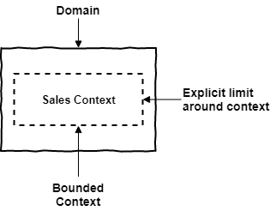
Bounded Context
Notes:
Bounded Context is where the Model is implemented

Slide 115
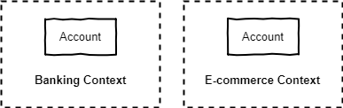
Bounded Context
Notes:
easy to identify that ‘Account‘ has different meanings in these two contexts.
In banking : ‘Account‘ refers to subjects such as money, transactions, payments, credit, and may belong to a person or company.
In e-commerce, ‘Account‘ refers to subjects such as login, account creation, password change and so on.

Slide 116
Domains and Subdomains
a sphere of knowledge or activity in the real world
But why does decomposition matter??
Notes:
has its own language, concepts, rules, and practices
e-commerce platform. The subdomain of “Order Management” can be further decomposed into smaller subdomains such as “Shopping Cart Management”, “Payment Processing”, “Shipping and Logistics”, and “Order Fulfillment”, etc.
The level of decomposition depends on the complexity of the business domain
Decomposition is necessary to manage the complexity of large software systems.\
into smaller subdomains, the team can better understand the business requirements and the software’s behavior.
developed and updated independently, which allows for greater agility and flexibility in responding to changing business needs.
subdomains can be assigned to different teams

Slide 117
Bounded Contexts and Subdomains
Subdomains live in the space of the problem and
the Bounded Contexts in the solution space.
Notes:
It is only natural when we start studying DDD that we find content that makes it difficult to differentiate between Bounded Contexts and Subdomains, since they both represent “segregation”.
Subdomains live in the space of the problem and the Bounded Contexts in the solution space.
Subdomains are logical “separations” of the domain and Bounded Contexts are technical solutions.

Slide 118
Bounded Contexts and Subdomains
Subdomain of order fulfillment
shipping system
returns system
warehouse management
Notes:
Example
Now, let’s take the subdomain of order fulfillment as an example. Within order fulfillment, there could be several bounded contexts, such as the shipping system, the returns system, and the warehouse management system. Each of these bounded contexts would have their own specific models, language, and rules that are distinct from the other bounded contexts within the same subdomain.
Yes, duplication can happen across bounded contexts, especially for entities that exist in multiple contexts but have different attributes or behavior.

Slide 119
Bounded Context Recommendations
Team assigned to a Bounded Context
Separate repository
One to many relationship
Notes:
Teams and Source Code Repositories :
There must be a team assigned to work on a Bounded Context.
There should be a separate source code repository for each Bounded Context.
It is possible that one team can work in several Bounded Context, but several teams should not work in a single Bounded Context.

Slide 120
Characteristic Scope
Case Study: Going, Going, Gone
Description:
An auction company wants to take its auctions online to a nationwide scale. Customers choose the auction to participate in, wait until the auction begins, then bid as if they are there in the room with the auctioneer.
Users:
Scale up to hundreds of participants per auction, potentially up to thousands of participants, and as many simultaneous auctions as possible.
Requirements:
Auctions must be as real-time as possible.
Bidders register with a credit card; the system automatically charges the card if the bidder wins.
Participants must be tracked via a reputation index.
Bidders can see a live video stream of the auction and all bids as they occur.
Both online and live bids must be received in the order in which they are placed.
Additional context:
The auction company is expanding aggressively by merging with smaller competitors.
The budget is not constrained. This is a strategic direction.
The company just exited a lawsuit where it settled a suit alleging fraud.

Slide 121
Characteristic Scope
Case Study: Going, Going, Gone
“Nationwide scale,”
“scale up to hundreds of participants per auction, potentially up to thousands of participants, and as many simultaneous auctions as possible,”
“auctions must be as real-time as possible.”
Notes:
An architect must consider each of these requirements to ascertain architecture characteristics:
Each of these requirements implies both scalability and elasticity. While the requirements explicitly call out scalability, elasticity represents implicit characteristics. When considering auctions, do users all politely spread themselves out during the course of bidding, or do they become more frantic near the end? Domain knowledge is crucial for architects to pick up implicit architecture characteristics. Given the real-time nature of auctions, an architect will certainly consider performance a key architecture characteristic.

Slide 122
Characteristic Scope
Case Study: Going, Going, Gone
“Bidders register with a credit card; the system automatically charges the card if the bidder wins,”
“company just exited a lawsuit where it settled a suit alleging fraud.”
Notes:
Both these requirements clearly point to security which is an implicit architecture characteristic in virtually every application. Should an architect design something special to accommodate security, or will general design and coding hygiene suffice? For example, as long as developers make sure not to store credit card numbers in plain text, to encrypt while in transit, and so on, then the architect shouldn’t have to build special considerations for security.
However, the second phrase should make an architect pause and ask for further clarification. Clearly, some aspect of security (fraud) was a problem in the past, thus the architect should ask for further input no matter what level of security they design.

Slide 123
Characteristic Scope
Case Study: Going, Going, Gone
“Participants must be tracked via a reputation index.”
“Auction company is expanding aggressively by merging with smaller competitors.”
Notes:
The track part of this requirement might suggest characteristics such as auditability and loggability. The deciding factor again goes back to the defining characteristic—is this outside the scope of the problem domain? Architects must remember that yielding architecture characteristics represents only a small part of the overall effort to design .
“Auction company is expanding aggressively by merging with smaller competitors.”
This requirement may not have an immediate impact on application design, it might become the determining factor in a trade-off like choosing details such as communication protocols for integration architecture if integration with newly merged companies is a concern.

Slide 124
Characteristic Scope
Case Study: Going, Going, Gone
“Bidders can see a live video stream of the auction and all bids as they occur,”
“both online and live bids must be received in the order in which they are placed.”
Notes:
This requirement presents an interesting architectural challenge, definitely impacting the structure of the application.
Is the availability of the one auctioneer more important than availability for one of the hundreds of bidders?
Obviously, one is clearly more critical: if the auctioneer cannot access the site, online bids cannot occur for anyone.
Reliability commonly appears with availability; it addresses operational aspects such as uptime, as well as data integrity and other measures of how reliable an application is. For example, in an auction site, the architect must ensure that the message ordering is reliably correct.
This last requirement highlights the need for using the architecture quantum measure as architects scope architecture characteristics at the quantum level. For example, in Going, Going, Gone, an architect would notice that different parts of this architecture need different characteristics: streaming bids, online bidders, and the auctioneer are three obvious choices. The architecture quantum measure is a way to think about deployment, coupling, where data should reside, and communication styles within architectures. In this kata, an architect can analyze the differing architecture characteristics per architecture quantum, leading to hybrid architecture design earlier in the process.

Slide 125

Component-Based Thinking
Notes:
architects typically think in terms of components, the physical manifestation of a module.
Developers physically package modules in different ways as we call components such as DLL files in .Net or JAR files in Java.
So we will discuss architectural considerations around components, ranging from scope to discovery.

Slide 126
Component Scope
Library
Service
Fundamental modular building blocks in architecture
Notes:
The simplest component is a wrapper that is often called a library which represents a higher level of modularity. It tends to run in the same memory address as the calling code and communicate via language function call mechanisms.
Components also appear as subsystems or layers in architecture.
Libraries are usually compile-time dependencies.
Another type of component, a service, tends to run in its own address space and communicates via low-level networking protocols like TCP/IP or higher-level formats like REST or message queues, forming stand-alone, deployable units in architectures like microservices.
Components, as the fundamental modular building blocks in architecture, are a critical consideration for architects, particularly in making decisions regarding the top-level partitioning within the architecture.

Slide 127
Architect Role
Defines, refines, manages, and governs components within an architecture,
and in collaboration with …
Notes:
Typically, the architect defines, refines, manages, and governs components within an architecture. Software architects, in collaboration with business analysts, subject matter experts, developers, QA engineers, operations, and enterprise architects,
incorporating the architecture characteristics and the requirements for the software

Slide 128
Architect Role
Architecture
Is independent from
Development process
Notes:
Virtually, architecture is independent from the development process, The primary exception is various flavors of Agile
Architects ultimately don’t care where requirements originate: waterfall-style analysis and design, Agile story cards...
Components consist of classes or functions, whose design falls under the responsibility of tech leads or developers.
Architects just should avoid micromanaging each decision from top to bottom in the system.
If architects never allow other roles to make decisions of consequence, the organization will struggle with empowering the next generation of architects.
An architect must identify components as one of the first tasks on a new project. But before an architect can identify components, they must know how to partition the architecture.

Slide 129
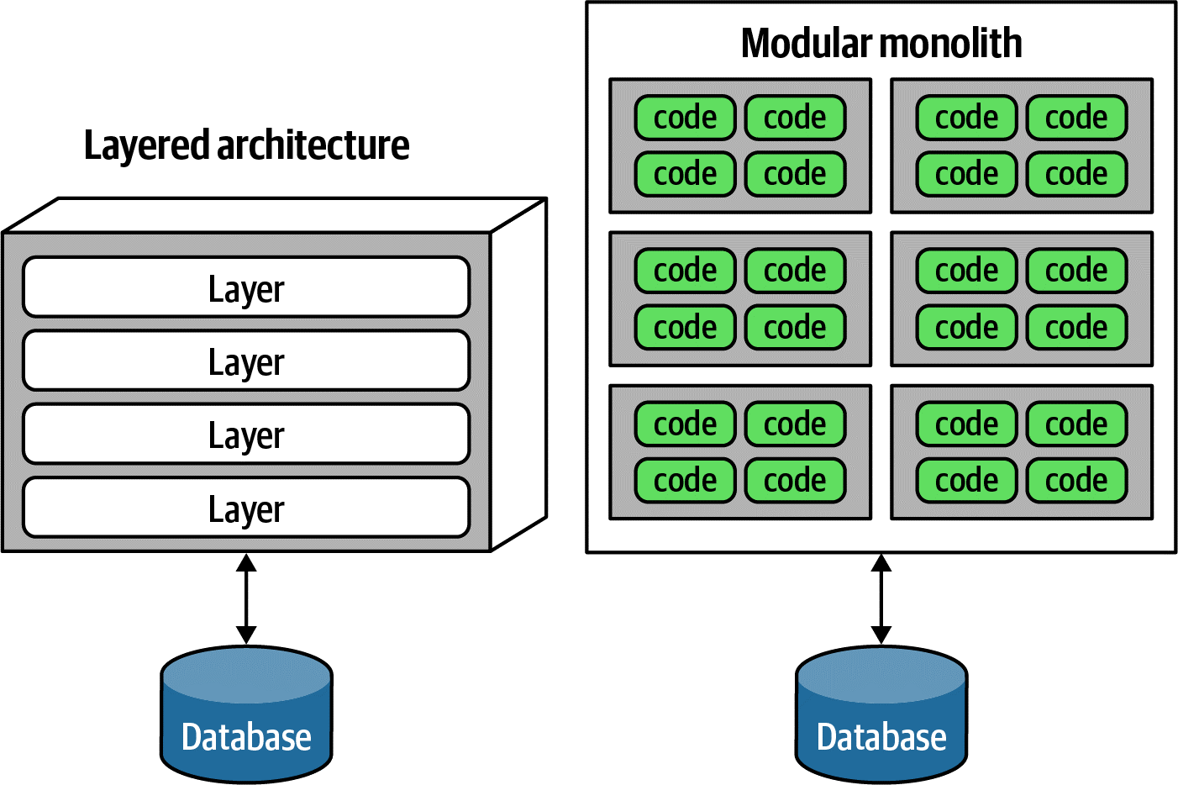
Architecture Partitioning
Notes:
Several common styles of top-level portioning exist, with different sets of trade-offs.
The top-level partitioning defines the fundamental architecture style and way of partitioning code.
The modular monolith, partitioned around domains rather than technical capabilities.
both represent different ways to top-level partition the architecture.
The Model-View-Controller design pattern matches with layered architecture, making it easy for developers to understand. often the default architecture in many organizations.

Slide 130
Conway's Law
Organizations which design systems … are constrained to produce designs which are copies of the communication structures of these organizations.
Notes:
An interesting side effect of the predominance of the layered architecture is that it makes some sense to have all the backend developers sit together in one department, the DBAs in another, the presentation team in another, and so on. Because of Conway’s law, this makes some sense.
This law suggests that when a group of people designs some technical artifact, the communication structures between the people end up replicated in the design. People at all levels of organizations see this law in action, and they sometimes make decisions based on it.
A well-designed architecture aligns with the organizational structure, promoting clearer communication, better-defined roles, and more efficient collaboration and resource allocation.

Slide 131
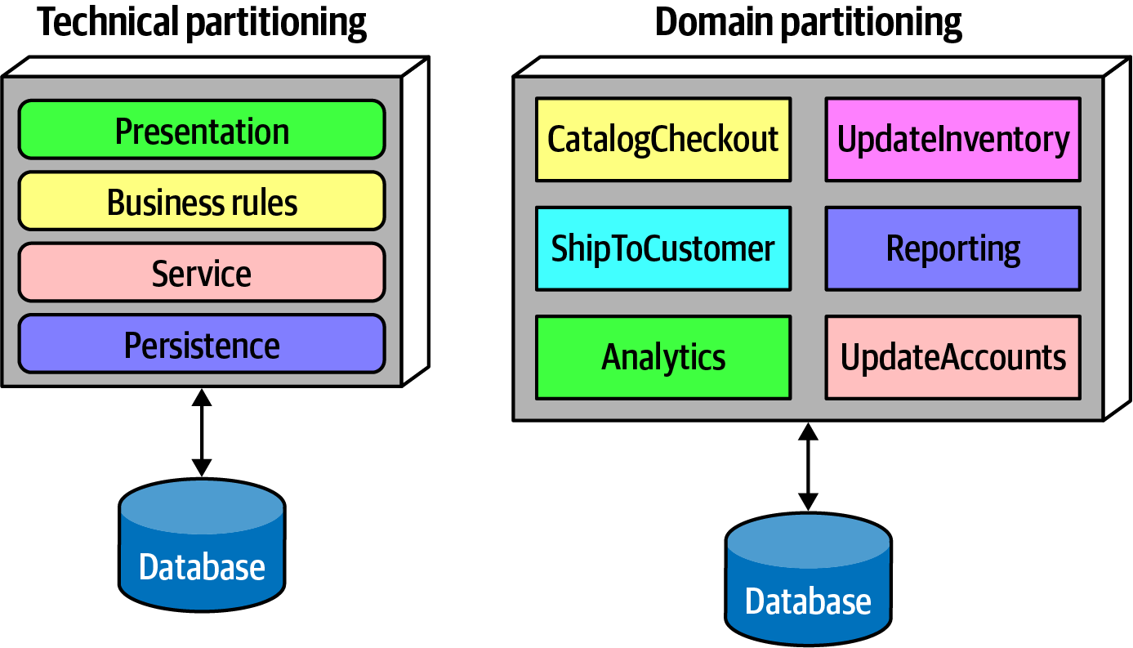
Architecture Partitioning
Notes:
Domain Partitioning
In DDD, the architect identifies domains or workflows independent and decoupled from each other.
The microservices architecture style is based on this philosophy.
In a modular monolith, the architect partitions the architecture around domains or workflows rather than technical capabilities.
As components often nest within one another, each of the components in Figure in the domain partitioning (for example, CatalogCheckout) may use its own persistence library and have a separate layer for business rules, but the top-level partitioning revolves around domains.
One of the fundamental distinctions between different architecture patterns is what type of top-level partitioning each supports.
Does the architect want to partition things technically or by domain?

Slide 132
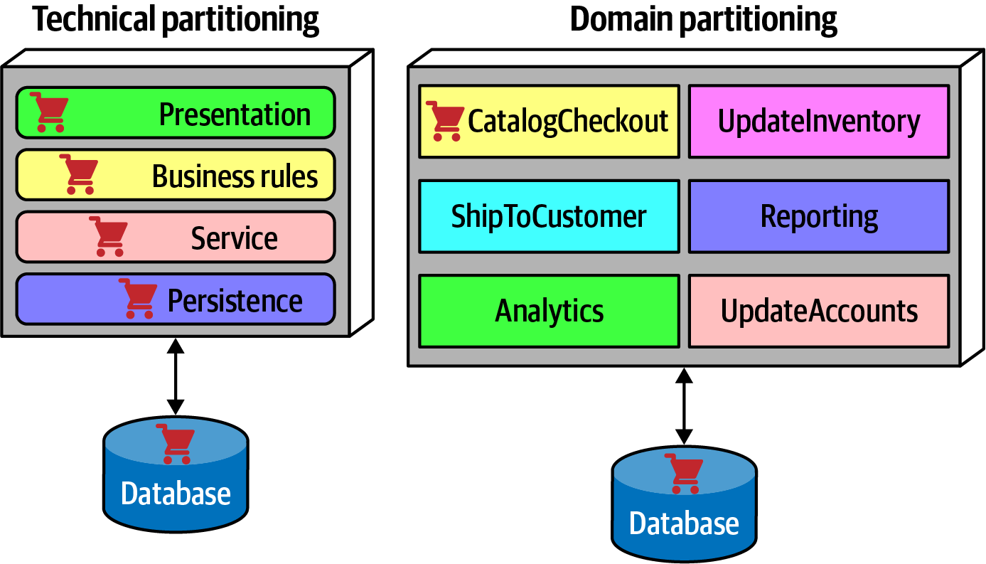
Architecture Partitioning
Notes:
Technical partitioning has one of the organizing principles which is separation of technical concerns. This in turn creates useful levels of decoupling: if the service layer is only connected to the persistence layer below and business rules layer above, then changes in persistence will only potentially affect those layers. It is certainly logical to organize systems using technical partitioning, but of course this offers some trade-offs.
The separation enforced by technical partitioning enables developers to find certain categories of the code base quickly.
However, most realistic software systems require workflows that cut across technical capabilities.
The code to handle CatalogCheckout in the technically layered architecture appears in all the layers.
Contrast this with domain partitioning, which uses a top-level partitioning by domain. Each component in the domain partitioning may have subcomponents, including layers.
Neither of these styles is more correct than the other—refer to the First Law of Software Architecture. That said, we have observed a decided industry trend over the last few years toward domain partitioning for the monolithic and distributed (for example, microservices) architectures. However, it is one of the first decisions an architect must make.

Slide 133
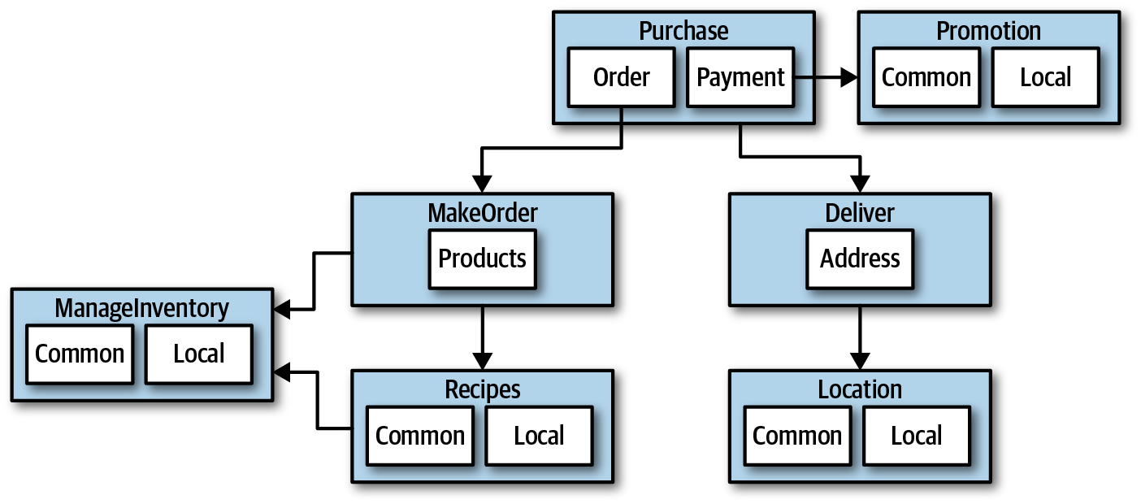
Case Study: Silicon Sandwiches: Partitioning
Notes:
one of the fundamental decisions facing an architect is the top-level partitioning.
The architect has designed around Domains (workflows), creating discrete components for Purchase, Promotion, MakeOrder,...
Within many of these components resides a subcomponent to handle the various types of customization required (ex : local and common subcomponents).
An alternative design isolates the common and local parts into their own partition, illustrated in the next Figure.

Slide 134
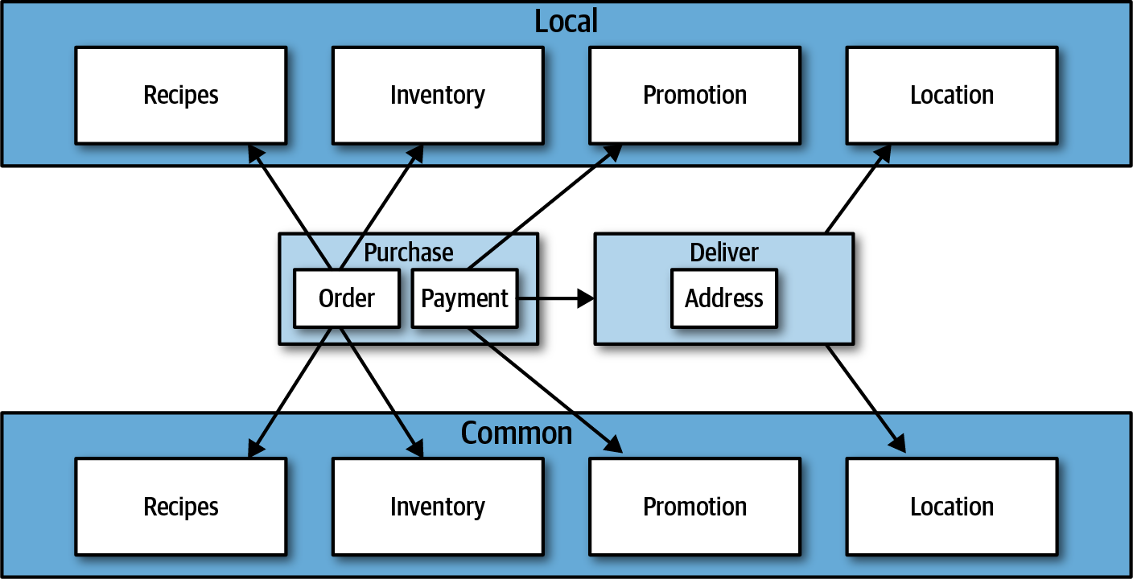
Case Study: Silicon Sandwiches: Partitioning
Notes:
Common and Local represent top-level components, with Purchase and Delivery remaining to handle the workflow.
Which is better? It depends! Each partitioning offers different advantages and drawbacks.

Slide 135
Case Study: Silicon Sandwiches: Partitioning
Technical Partitioning
Domain Partitioning
Which is better? It depends!
Notes:
Domain partitioning
Domain-partitioned architectures separate top-level components by workflows and/or domains.
Advantages
Focus on how the business functions and message flow matches the problem domain.
Easier to build cross-functional teams around domains (Conways’ Law) (Cross-functional teams bringing together members from different functional areas.).
Easy to be aligned and migrate data and components to distributed architecture (the modular monolith and microservices architecture styles). Disadvantage
Customization code appears in multiple places.

Slide 136
Case Study: Silicon Sandwiches: Partitioning
Technical Partitioning
Domain Partitioning
Which is better? It depends!
Notes:
Technical partitioning
Technically partitioned architectures separate top-level components based on technical capabilities. This may manifest as layers inspired by Model-View-Controller separation. In Example it separates components based on customization.
Advantages
Clearly separates customization code.
Aligns more closely to the layered architecture pattern.
Disadvantages
Higher degree of global coupling as changes to local or common components may affect all the others.
For ex : calculateDiscount in local changed , it will affect or need required modification to some domains code parts .
Developers may have to duplicate domain concepts in both common and local layers.
Typically higher coupling at the data level. In a system like this, the architects would likely create a single database, including customization and domains. That in turn creates difficulties in untangling the data relationships if the architects later want to migrate this architecture to a distributed system.

Slide 137

Developer Role
Class and function design is a shared responsibility
Notes:
Developers typically take components, designed with the architect role, and further subdivide them into classes, functions, or subcomponents. In general, class and function design is the shared responsibility of architects, tech leads, and mostly developers.
Developers should never take components designed by architects as the last word; all software design benefits from iteration. Rather, that initial design should be viewed as a first draft, where implementation will reveal more details and refinements.

Slide 138
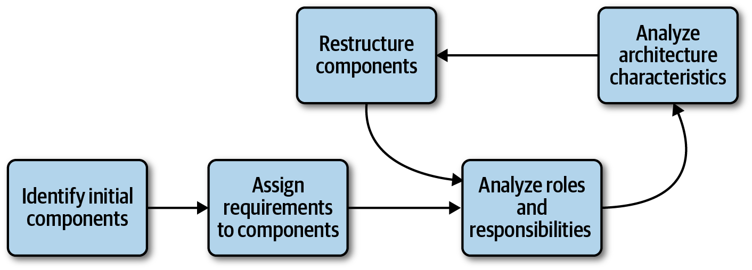
Component Identification Flow
Iterative approach makes it almost perfect
Notes:
Component identification works best as an iterative process, producing candidates and refinements through feedback..
Identifying Initial Components
Before any code exists, the architect must determine what TOP-Level components to begin with, based on partitioning they choose.
Initially, An architect should map domain functionality to the components to see where behavior should reside.
Also The likelihood of achieving a good design from this initial is small, that’s why architects must iterate to improve.
an architect should map domain functionality to the components to see where behavior should reside.
Align Requirements to Components (More deeply)
The next step aligns requirements (or user stories) to those components to see how well they fit.
This may entail creating new components, consolidating existing ones, or breaking components apart because they have too much responsibility.
also think about the roles, responsibilities and behaviors to align the components and domain correct granularity as it one of the greatest challenges ,solved by the iterative approach.
Analyze Architecture Characteristics
the architect should also look at the architecture characteristics discovered earlier in order to think about how they might impact component division and granularity. For example, while two parts of a system might deal with user input, the part that deals with hundreds of concurrent users will need different architecture characteristics than another part that needs to support only a few. Thus, it might yield a single component to handle user interaction, analyzing the architecture characteristics will lead to a subdivision.
Restructure Components with developers
Feedback is critical in software design. Thus, architects must continually iterate on their component design with developers. First, it’s impossible to account for all the different edge cases. Secondly, as the architecture and developers delve more deeply into building the application, they gain a more nuanced understanding of where behavior and roles should lie.

Slide 139
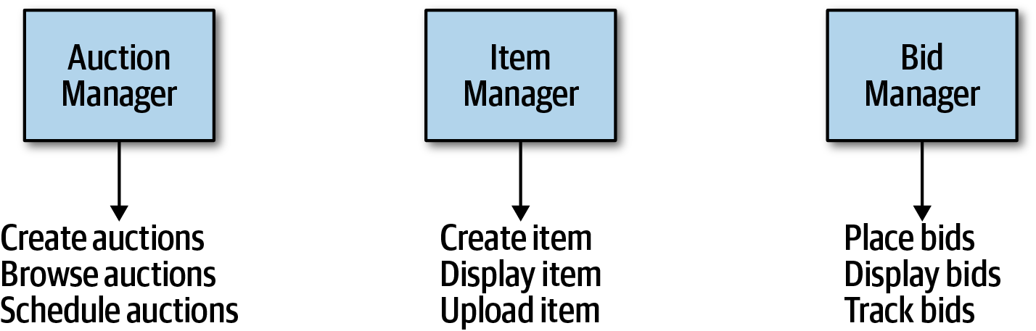
Component Design
Entity Trap
Notes:
No accepted “correct” way exists to design components. Rather, a wide variety of techniques exist, all with various trade-offs.
A common anti-pattern may lurk: the entity trap. Say that an architect is working on designing components for kata Going, Going, Gone and ends up with that figure.
The architect has basically taken each entity identified in the requirements and made a Manager component based on that entity.
This isn’t an architecture; it’s an object-relational mapping (ORM) of a framework to a database.
The entity trap anti-pattern arises when an architect incorrectly identifies the database relationships as workflows in the application which indicates lack of thought about the actual workflows.

Slide 140
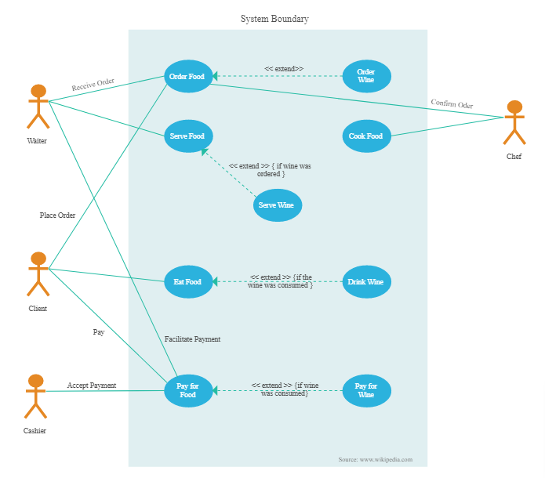
Component Design
Actor/Actions approach
Notes:
The actor/actions approach is a popular way that architects use to map requirements to components. In this approach, originally defined by the Rational Unified Process Called Use Case Diagram, architects identify actors/users who perform activities with the application and the actions those actors may perform.
This style of component decomposition works well for all types of systems, monolithic or distributed.

Slide 141
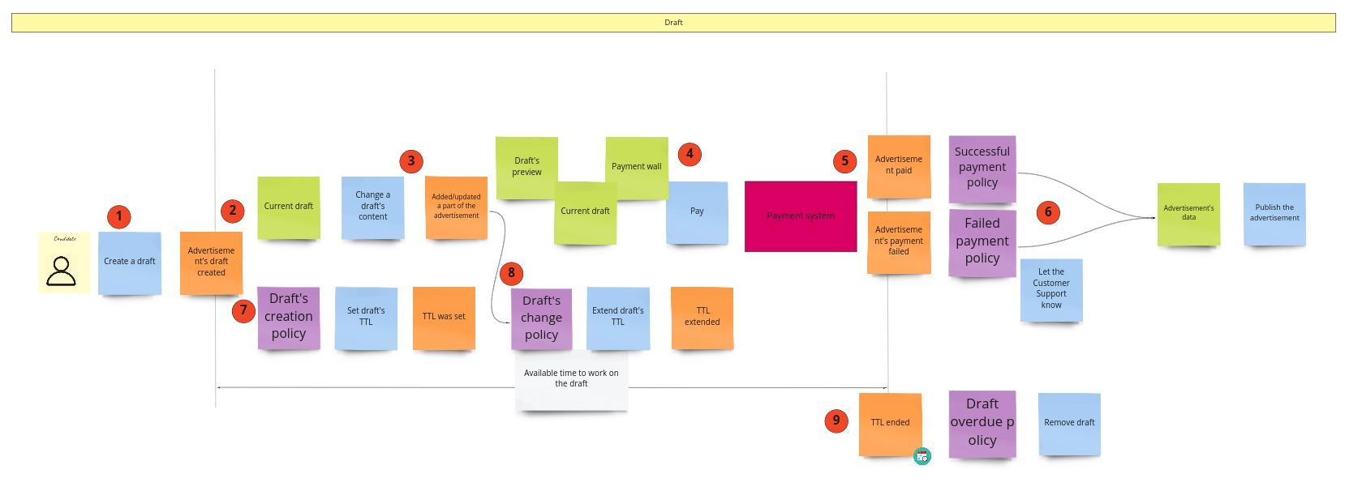
Component Design
Event storming
Notes:
/// Todo : Need revision on the actual difference between it and the workflow approach (flow chart)
Event storming as a component discovery technique comes from domain-driven design (DDD) and shares popularity with microservices. In event storming, the architect assumes the project will use messages and/or events to communicate between the various components. The team tries to determine which events occur in the system based on requirements and identified roles, and build components around those event and message handlers. This works well in distributed architectures like microservices that use events and messages, because it helps architects define the messages used in the eventual system.

Slide 142
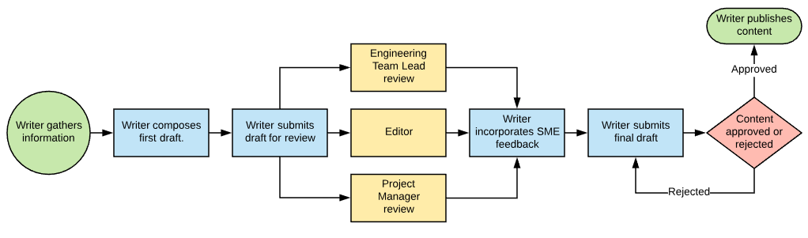
Component Design
Workflow Approach
Notes:
An alternative to event storming not using DDD or messaging. The workflow approach is by identifying the key roles and their workflows and modeling the components around these workflows, much like event storming, but without the explicit constraints of building a message-based system.
None of these techniques is superior to the others; all offer a different set of trade-offs. If a team uses a waterfall approach, they might prefer the Actor/Actions approach because it is general. When using DDD and corresponding architectures like microservices, event storming matches the software development process exactly.

Slide 143
Fundamentals of Software Architecture Part 2
Deep diving into software architecture with practical case studies, enabling architects to make efficient architecture decisions, and advance their careers to the next level.

Slide 145
CONTENTS
Here’s what you’ll learn:
Layered Architecture Style
ABP framework with layered architecture practical example
Microservice Architecture
Microservice Decomposition: A Case Study of a Large Industrial Software Migration in the Automotive Industry
Choosing the Appropriate Architecture Style
Diagramming and Presenting Architecture
Developing an Architect Career Path

Slide 146
01
02
03
Clarity on Core Principles
Best Practices for Long-term Design
Deep Dive into Software Architecture
Setting Expectations
04
05
Real-world Examples & Case Studies
Developing Architect Career Path

Slide 147
01
02
BUSINESS OVERVIEW
MARKET ANALYSIS
TABLE OF CONTENTS
03
04
MANAGEMENT PLAN
OPERATING PLAN
You can describe the topic of the section here
You can describe the topic of the section here
You can describe the topic of the section here
You can describe the topic of the section here

